Slide 1

18th IEEE International Conference on Vehicular Electronics and Safety 2024
Real-Time Incremental Federated Learning for
Weather Prediction with UAV based Data Collection
Priyansh Singhal
Dr. Piyush Joshi
Dept. Of Computer Science & Engineering,
Indian Institute Of Information Technology, Sri City
Dept. Of Computer Science & Engineering,
Indian Institute Of Information Technology, Sri City

Slide 2
Table Of Content
01
02
03
04
05
Introduction
Related Works
Dataset
Proposed Method
Results & Conclusion

Slide 3
01
Introduction
1. Accurate Weather Prediction & Limitations of Traditional Methods
Essential for sectors like agriculture, disaster management, and urban planning [1].
Traditional stationary weather stations often miss localized and dynamic weather changes, resulting in less accurate predictions [2].
Machine learning models struggle with quick adaptation to new, real-time data [2].
2. Contributions
Propose a UAV-based data collection system for comprehensive and dynamic weather data.
Develop a real-time incremental federated learning framework to process streaming weather data efficiently.
Introduce a weighted federated learning method for this application that improves prediction accuracy by incorporating model performance during federated averaging.

Slide 4
02
Related Works
1. Traditional (NWP Models & Ground-Based Sensors Enhancement)
Numerical Weather Prediction (NWP) Models proposed by uses mathematical simulations to predict atmospheric conditions [3].
Effective but limitations in accurately capturing weather patterns [3].
2. UAVs for Weather Forecasting
Can collect high-resolution and diverse weather data in real-time across various locations, offering more dynamic and comprehensive coverage [6].
The use of UAVs in weather monitoring is expanding, with ongoing research addressing challenges and exploring innovative solutions to enhance their effectiveness in various civil applications [8].

Slide 5
02
Related Works
3. Incremental Learning for Streaming Data
Large-scale approaches ensure that model performance remains consistent as new data is introduced over time [9].
Adaptive online incremental learning methods are tailored for evolving data streams, making them suitable for dynamic and rapidly changing environments [12].
4. Federated Learning
Involves averaging model updates from different clients to achieve a unified model [13].
Evolved from centralized to distributed on-site learning, expanding its relevance to fields like IoT and beyond [15].

Slide 6
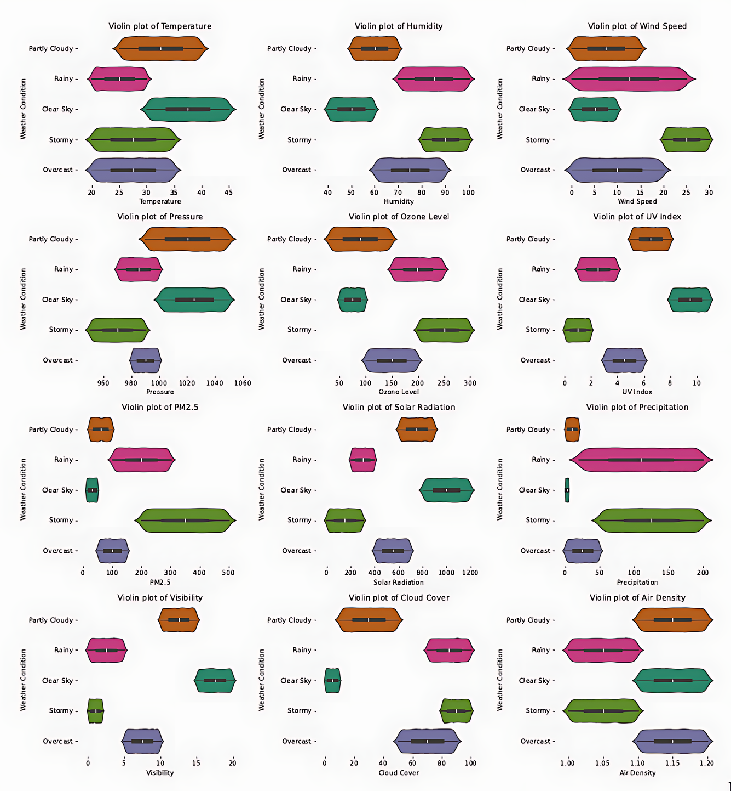
03
Dataset
1. Dataset Generation
Generated a synthetic dataset with 12 atmospheric features and 5 weather conditions, ensuring realistic, scientifically accurate values [1].
100,000 samples were evenly distributed across the weather conditions.
Violin plots were used to visualize the distribution and density of features across different weather labels.

Slide 7
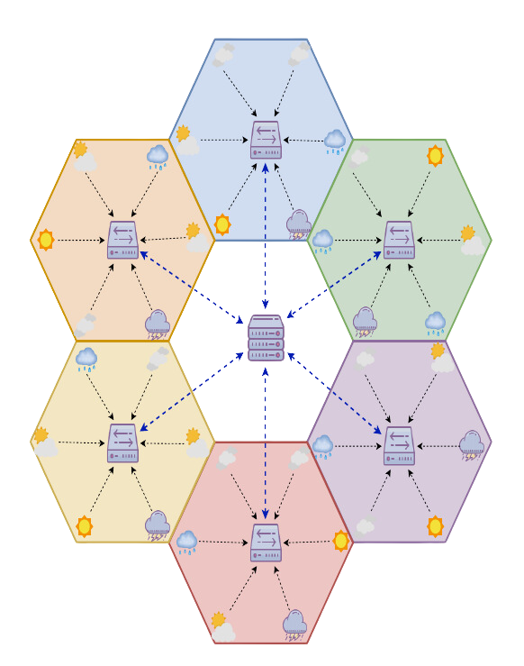
03
Dataset
2. Topology Definition & Data Collection
Defined a hierarchical topology with states and cities, where each hexagon represents a state and icons indicate city weather conditions.
Data collected from cities is processed by state central servers for local model training.
A global server aggregates these local models using a weighted federated learning algorithm, enhancing prediction accuracy.

Slide 8
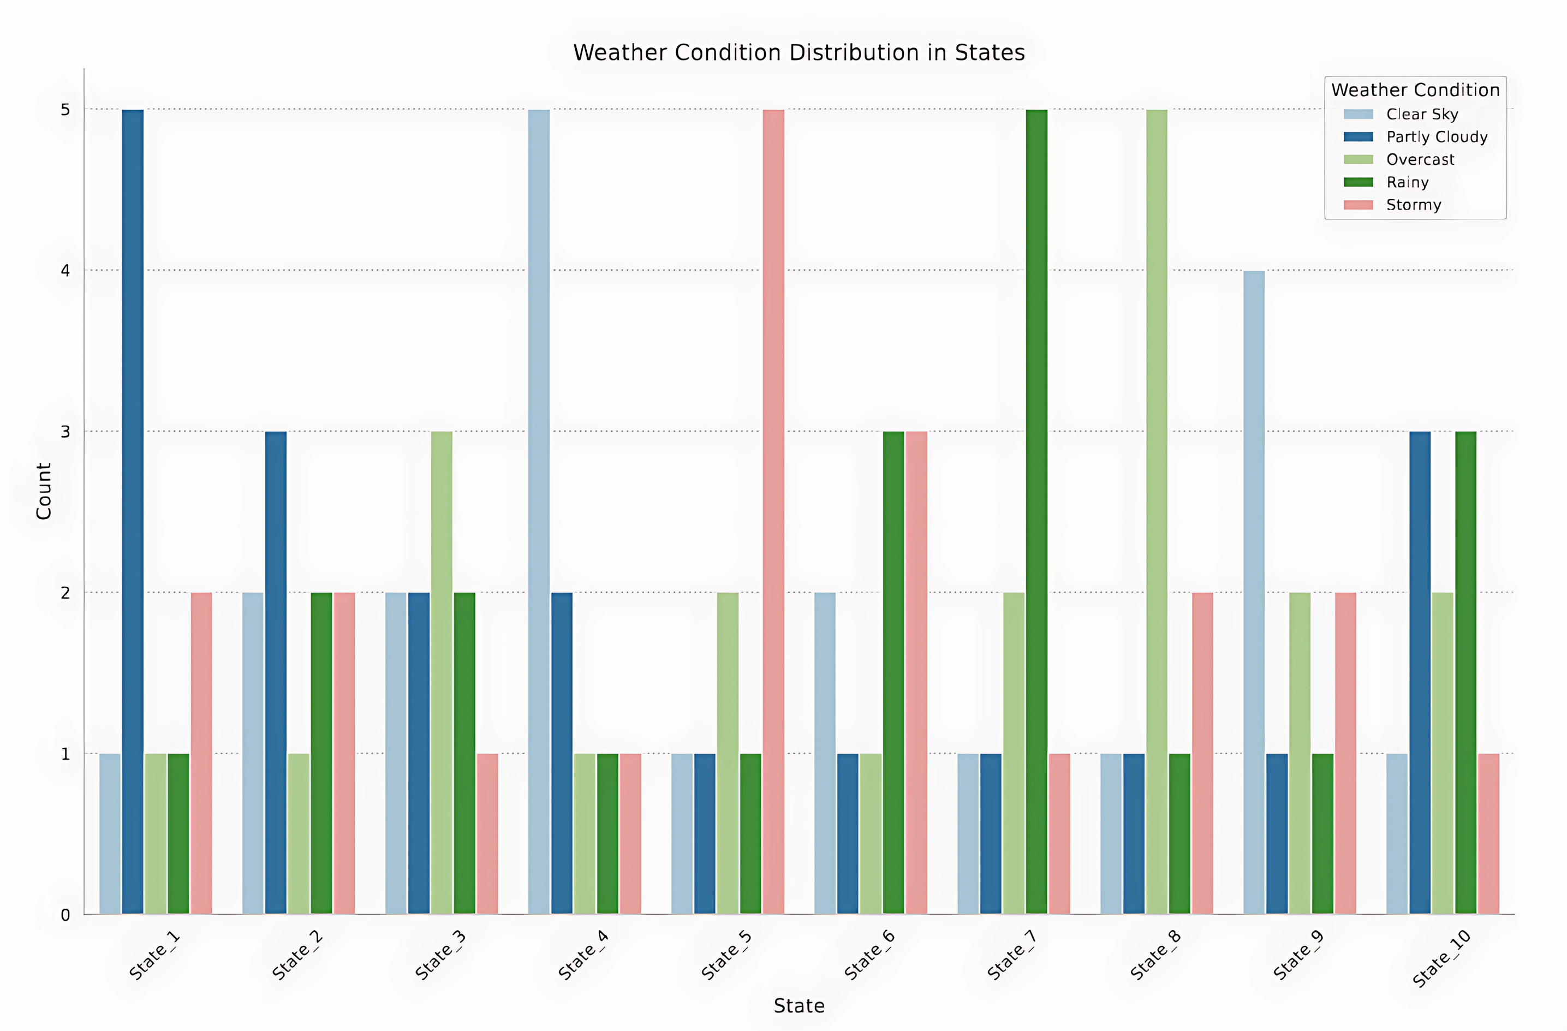

Slide 9
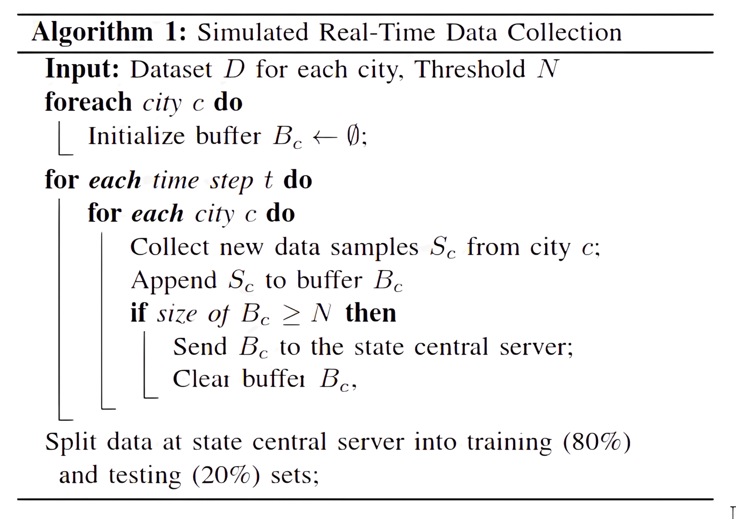

Slide 10
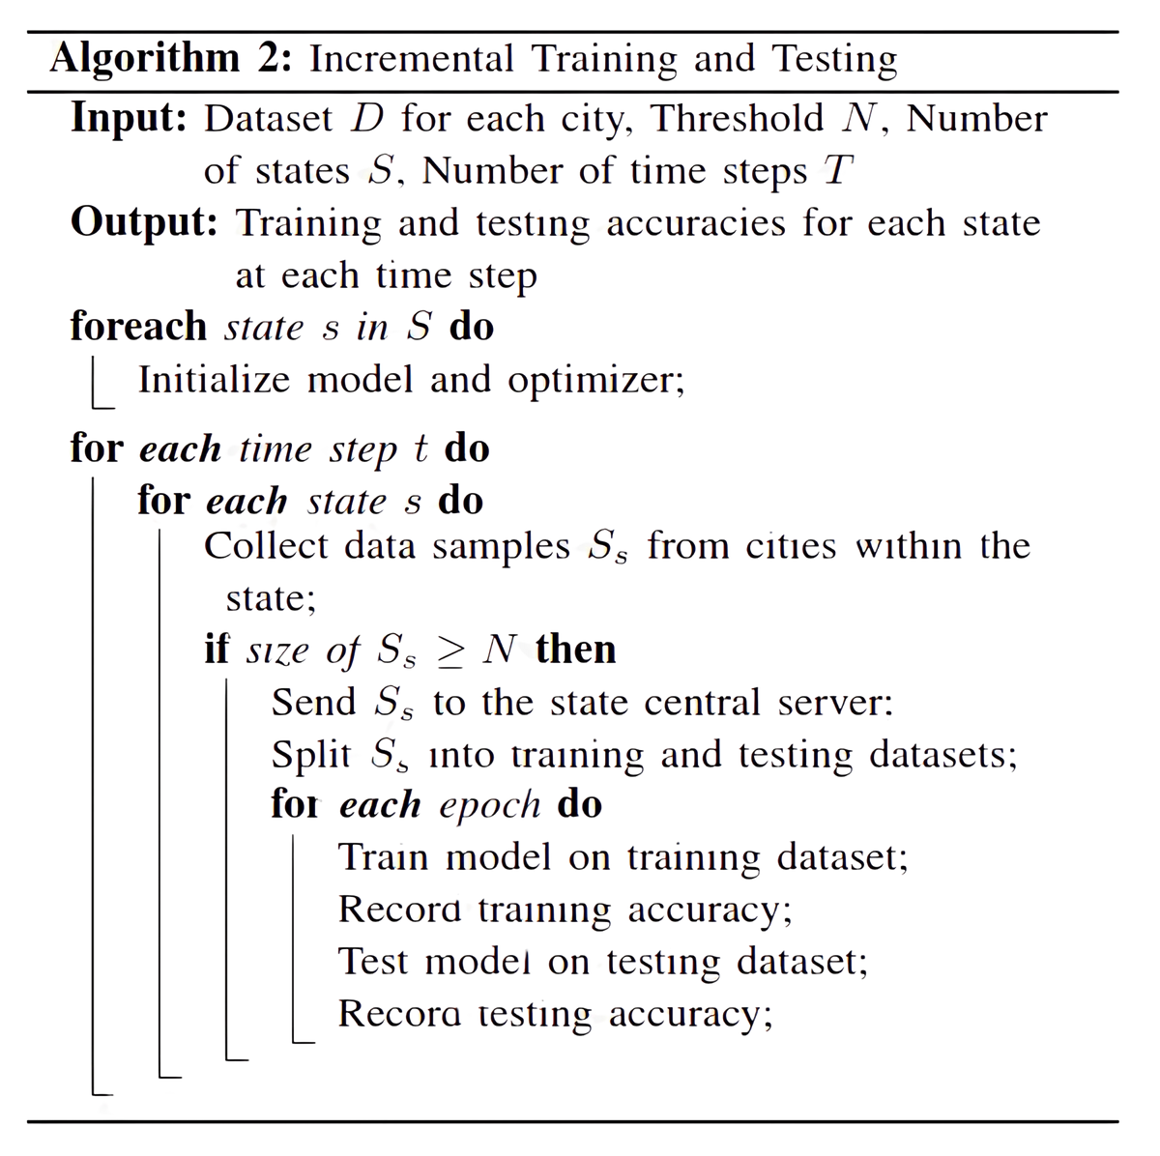
04
Methodology
1. Incremental Machine Learning
Neural network with 3 layers (8 input, 12 hidden, softmax output) & ReLU Activation function for the hidden layers.
Each state trains its model incrementally with real-time data updates.
In our use case scenario, total 10 local models being trained for each state.
Average Training and Testing accuracy across all models reported in the results section.

Slide 11
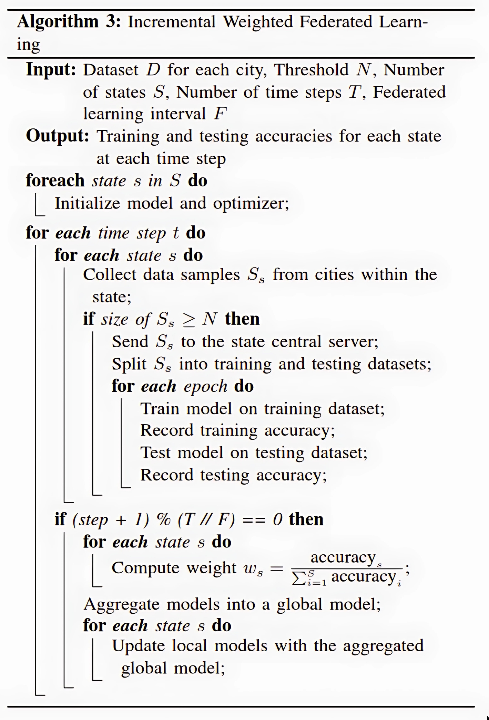
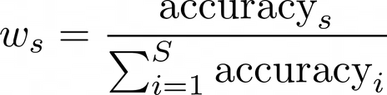
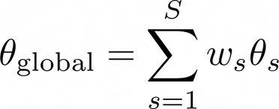
04
Proposed Method
2. Incremental Weighted Federated Learning
Periodic aggregation of local models weighted by performance
Weights for model aggregation was based on test accuracies:
Global model was created by aggregating weighted local models
Local models updated with aggregated global model parameters at every F step.

Slide 12
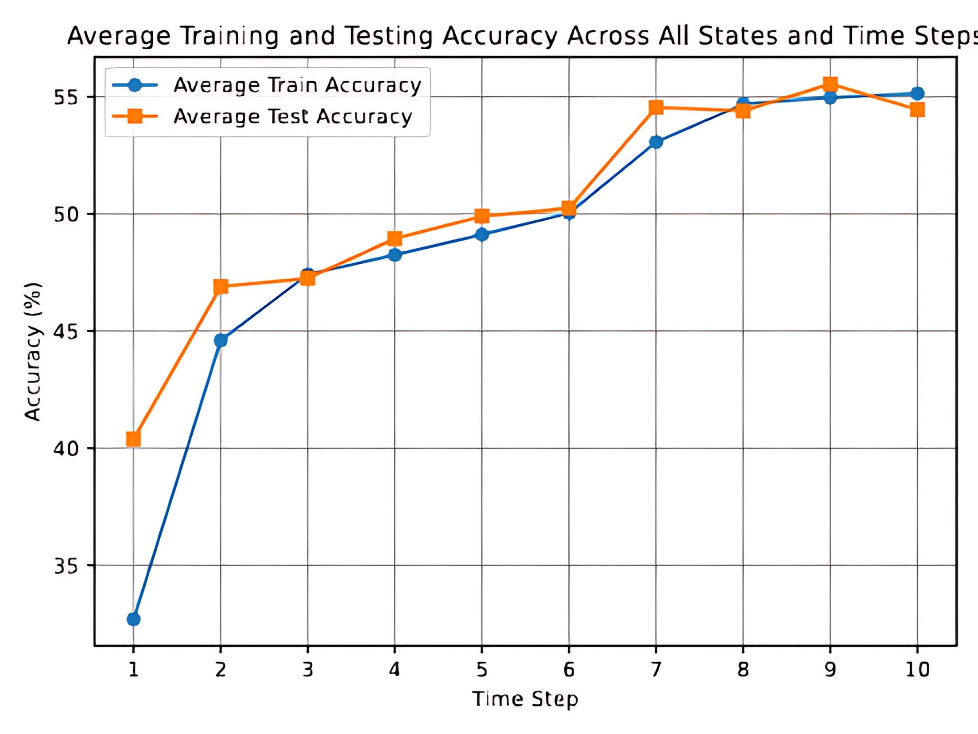
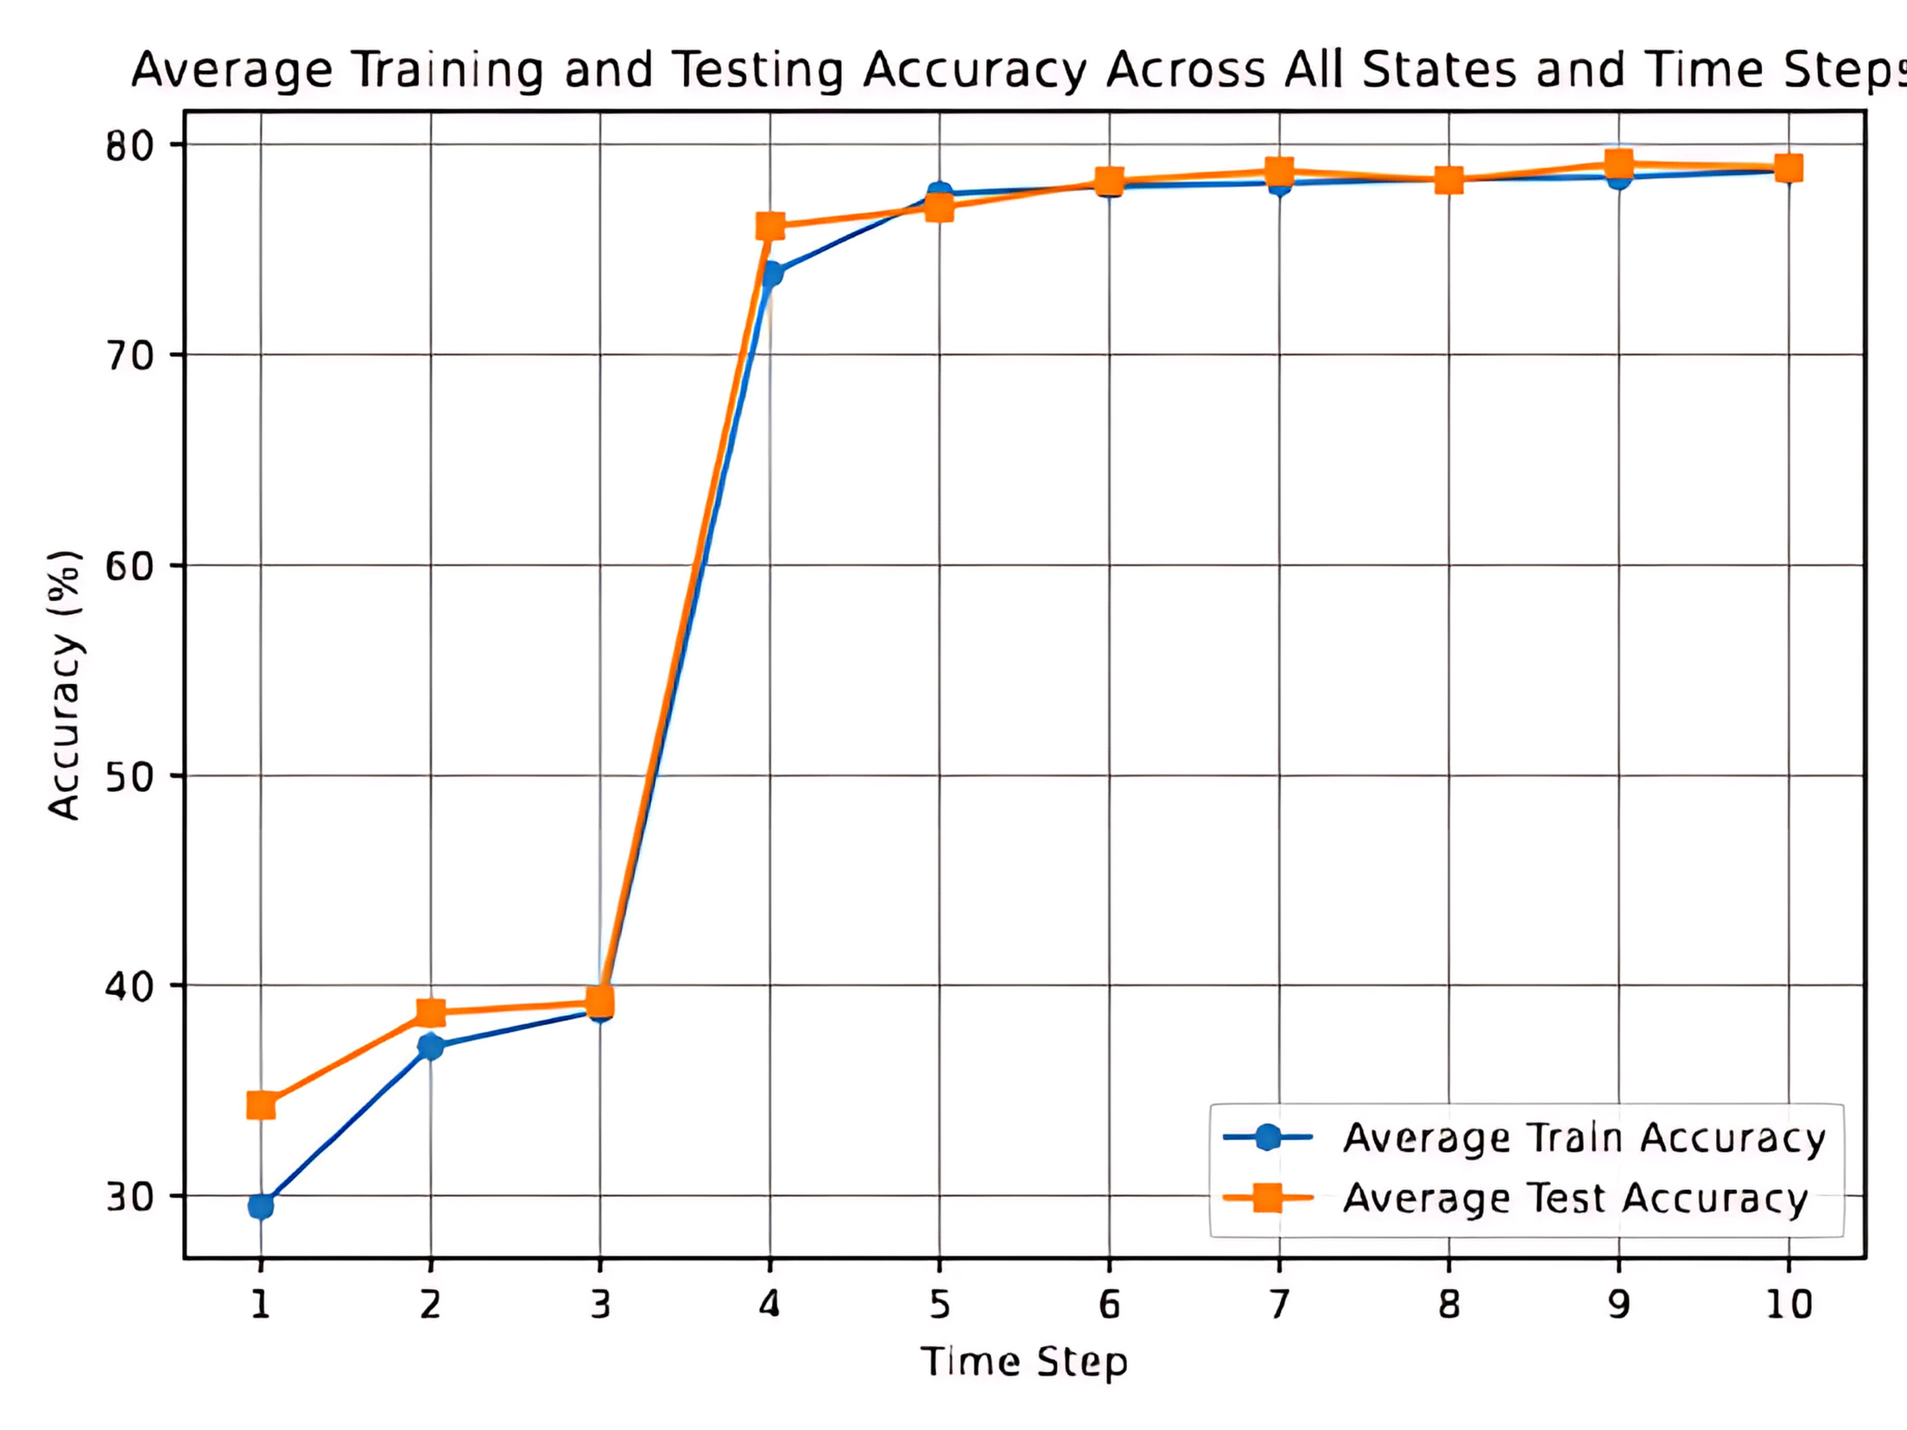
05
Results
Incremental Machine Learning
Incremental Weighted Federated Learning

Slide 13
05
Conclusions
Incremental ML:
Steady increase in accuracy initially, but plateaus after a few time steps
Indicates limitations in handling class imbalances.
Training and testing accuracies were close, indicating low overfitting.
Incremental Weighted Federated Learning (IWFL):
Significant accuracy boost after the first federated step at T = 3, due to weight aggregation across state models.
Effectively handled class imbalances and achieves a 24% increased accuracy in fewer steps than Incremental ML.

Slide 14
References
[1] B. Bochenek and Z. Ustrnul, “Machine learning in weather prediction and climate analyses—applications and perspectives,” Atmosphere, vol. 13, no. 2, 2022.
[2] A. Chodorek, R. R. Chodorek et al., “Weather sensing in an urban environment with the use of a uav and webrtcbased platform: A pilot study,” Sensors, vol. 21, 2021.
[3] A. C. Lorenc, “Analysis methods for numerical weather prediction,” Quarterly Journal of the Royal Meteorological Society, vol. 112, no. 474, 1986. [Online]. Available: https://doi.org/10.1002/qj.49711247414
[4] S. I. Gutman and S. G. Benjamin, “The role of groundbased gps meteorological observations in numerical weather prediction,” GPS Solutions, vol. 4, 2001. [Online]. Available: https://doi.org/10.1007/PL00012860
[5] R. Fabrizi, S. Bonafoni, and R. Biondi, “Satellite and ground-based sensors for the urban heat island analysis in the city of rome,” Remote Sensing, vol. 2, 2010. [Online]. Available: https://doi.org/10.3390/rs2051400
[6] M. K. Guin, S. Hiremath, and M. H. Shrishail, “Semi-autonomous uav based weather and air pollution monitoring system,” Journal of Physics: Conference Series, vol. 1921, 2021. [Online]. Available: https: //dx.doi.org/10.1088/1742-6596/1921/1/012091
[7] D. Sziroczak, D. Rohacs, and J. Rohacs, “Review of using small uav based meteorological measurements for road weather management,” Progress in Aerospace Sciences, 2022. [Online]. Available: https://doi.org/10.1016/j.paerosci.2022.100859
[8] H. Shakhatreh, A. H. Sawalmeh, A. Al-Fuqaha, Z. Dou, E. Almaita, I. Khalil, N. S. Othman, A. Khreishah, and M. Guizani, “Unmanned aerial vehicles (uavs): A survey on civil applications and key research challenges,” IEEE Access, vol. 7, pp. 48 572–48 634, 2019.
[9] H. He, S. Chen, K. Li, and X. Xu, “Incremental learning from stream data,” IEEE Transactions on Neural Networks, vol. 22, no. 12, pp. 1901–1914, 2011.
[10] Y. Wu, Y. Chen, L. Wang, Y. Ye, Z. Liu, Y. Guo, and Y. Fu, “Large scale incremental learning,” in Proceedings of the IEEE/CVF Conference on Computer Vision and Pattern Recognition (CVPR), June 2019.
[11] J. He, R. Mao, Z. Shao, and F. Zhu, “Incremental learning in online scenario,” in Proceedings of the IEEE/CVF conference on computer vision and pattern recognition, 2020, pp. 13 926–13 935.
[12] S. si Zhang, J. wei Liu, and X. Zuo, “Adaptive online incremental learning for evolving data streams,” Applied Soft Computing, vol. 105, p. 107255, 2021. [Online]. Available: https://doi.org/10.1016/j.asoc.2021.107255
[13] T. Li, A. K. Sahu, A. Talwalkar, and V. Smith, “Federated learning: Challenges, methods, and future directions,” IEEE Signal Processing Magazine, vol. 37, no. 3, pp. 50–60, 2020.
[14] S. Abdulrahman, H. Tout, H. Ould-Slimane, A. Mourad,C. Talhi, and M. Guizani, “A survey on federated learning: The journey from centralized to distributed on-site learning and beyond,” IEEE Internet of Things Journal, vol. 8, no. 7, pp. 5476–5497, 2021.
[15] K. Bonawitz, H. Eichner et al., “Towards federated learning at scale: System design,” Proceedings of machine learning and systems, vol. 1, pp. 374–388, 2019.
[16] B. Brik, A. Ksentini, and M. Bouaziz, “Federated learning for uavs-enabled wireless networks: Use cases, challenges, and open problems,” IEEE Access, vol. 8, pp. 53 841–53 849, 2020.

